Slide 1


Slide 2


Slide 3


Slide 4
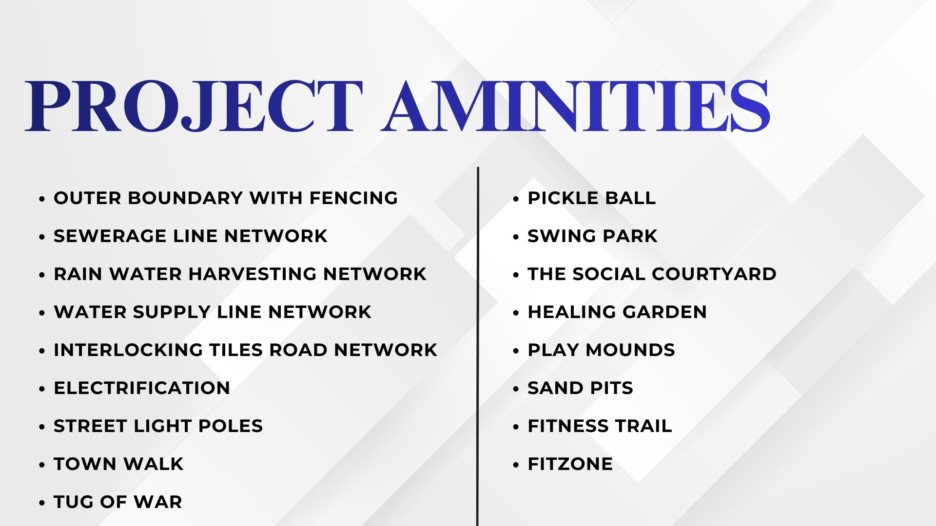


Slide 5
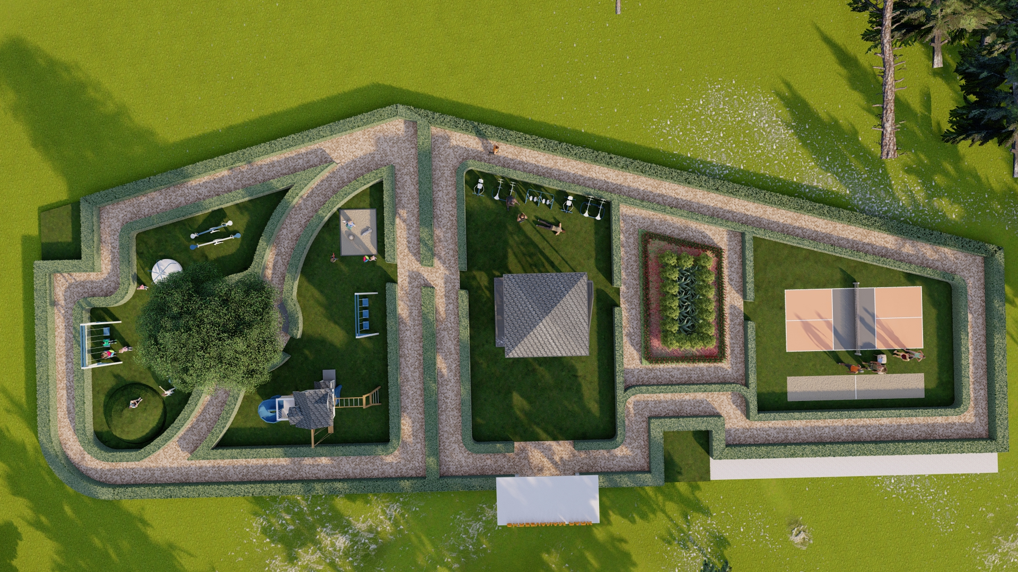

SHREEVANAM PARK

Slide 6
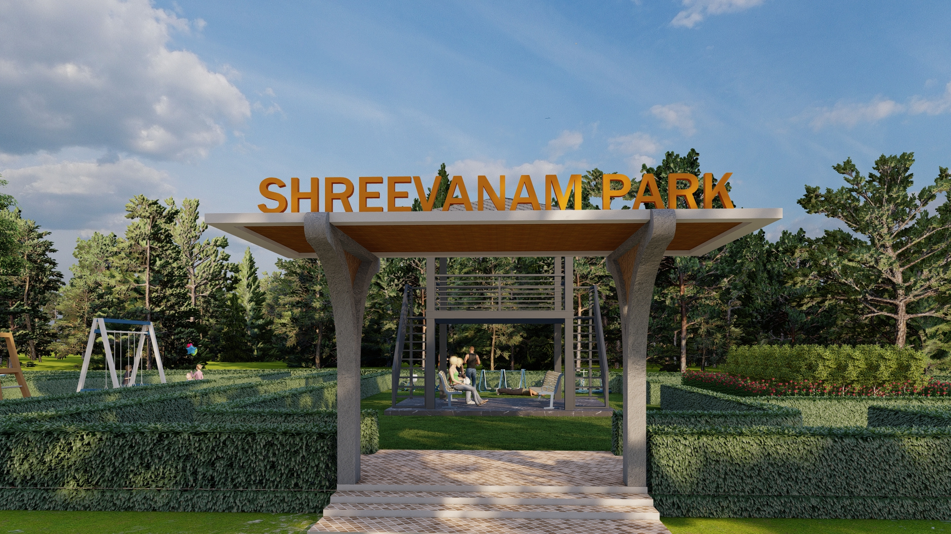
SHREEVANAM PARK

Slide 7
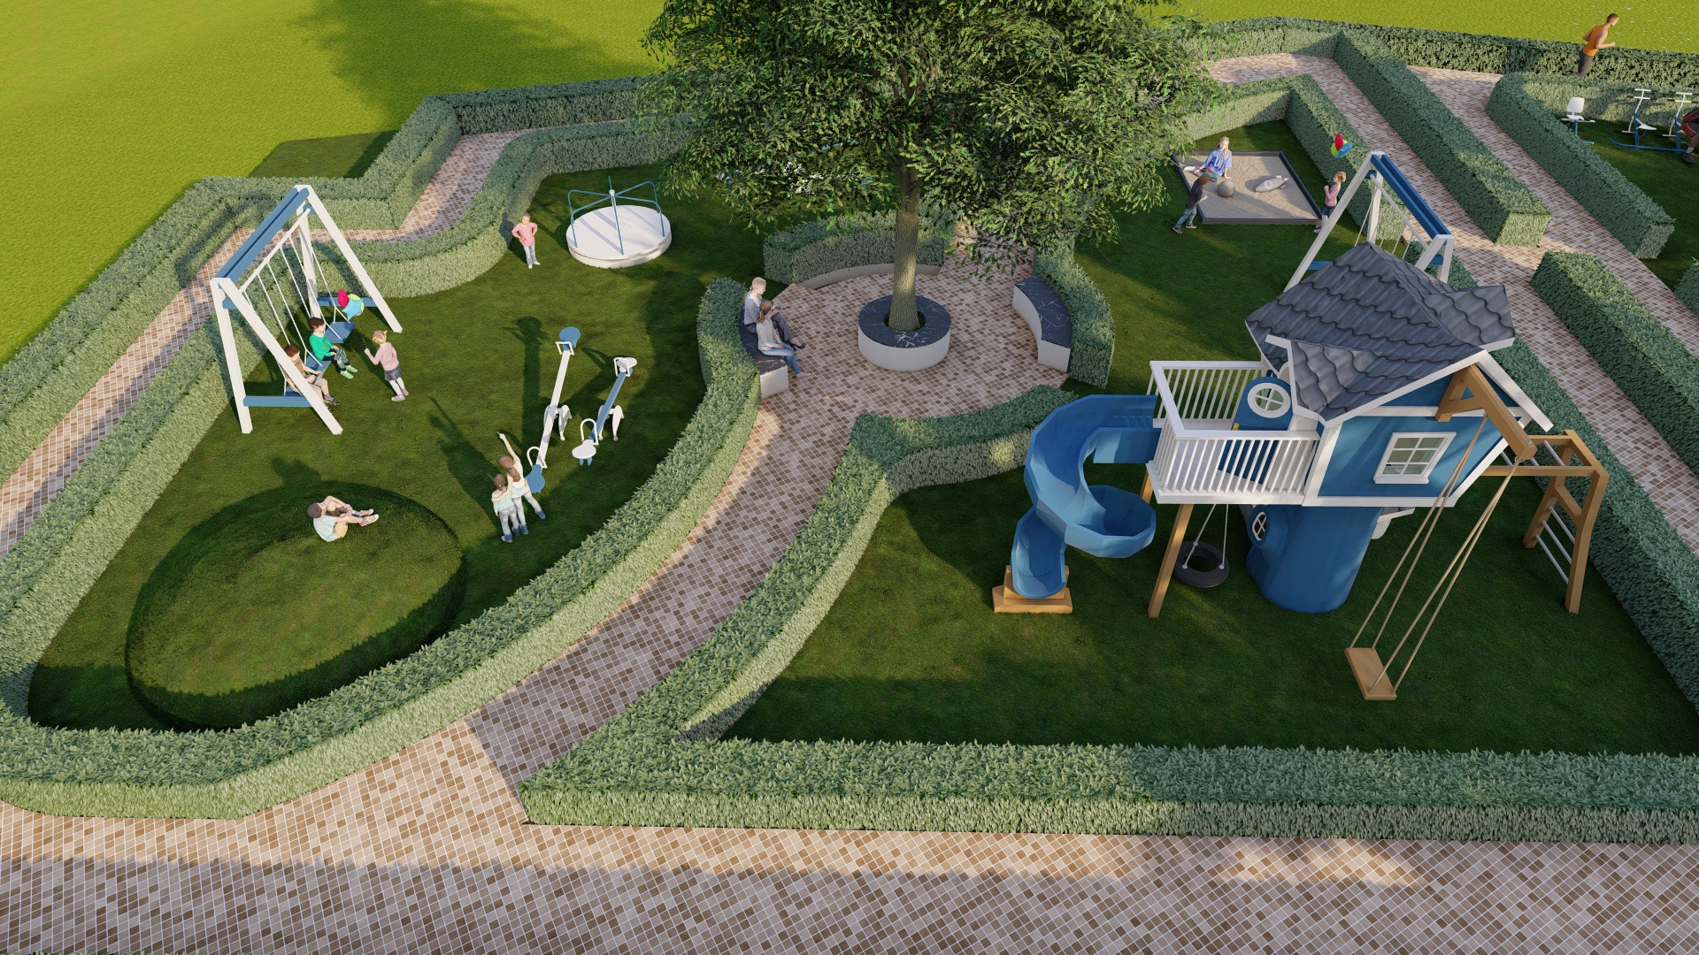
SWING PARK

Slide 8
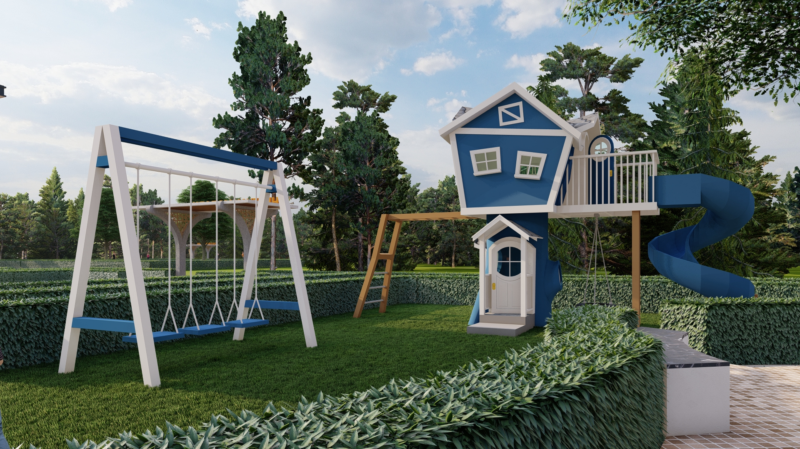

SWING PARK

Slide 9
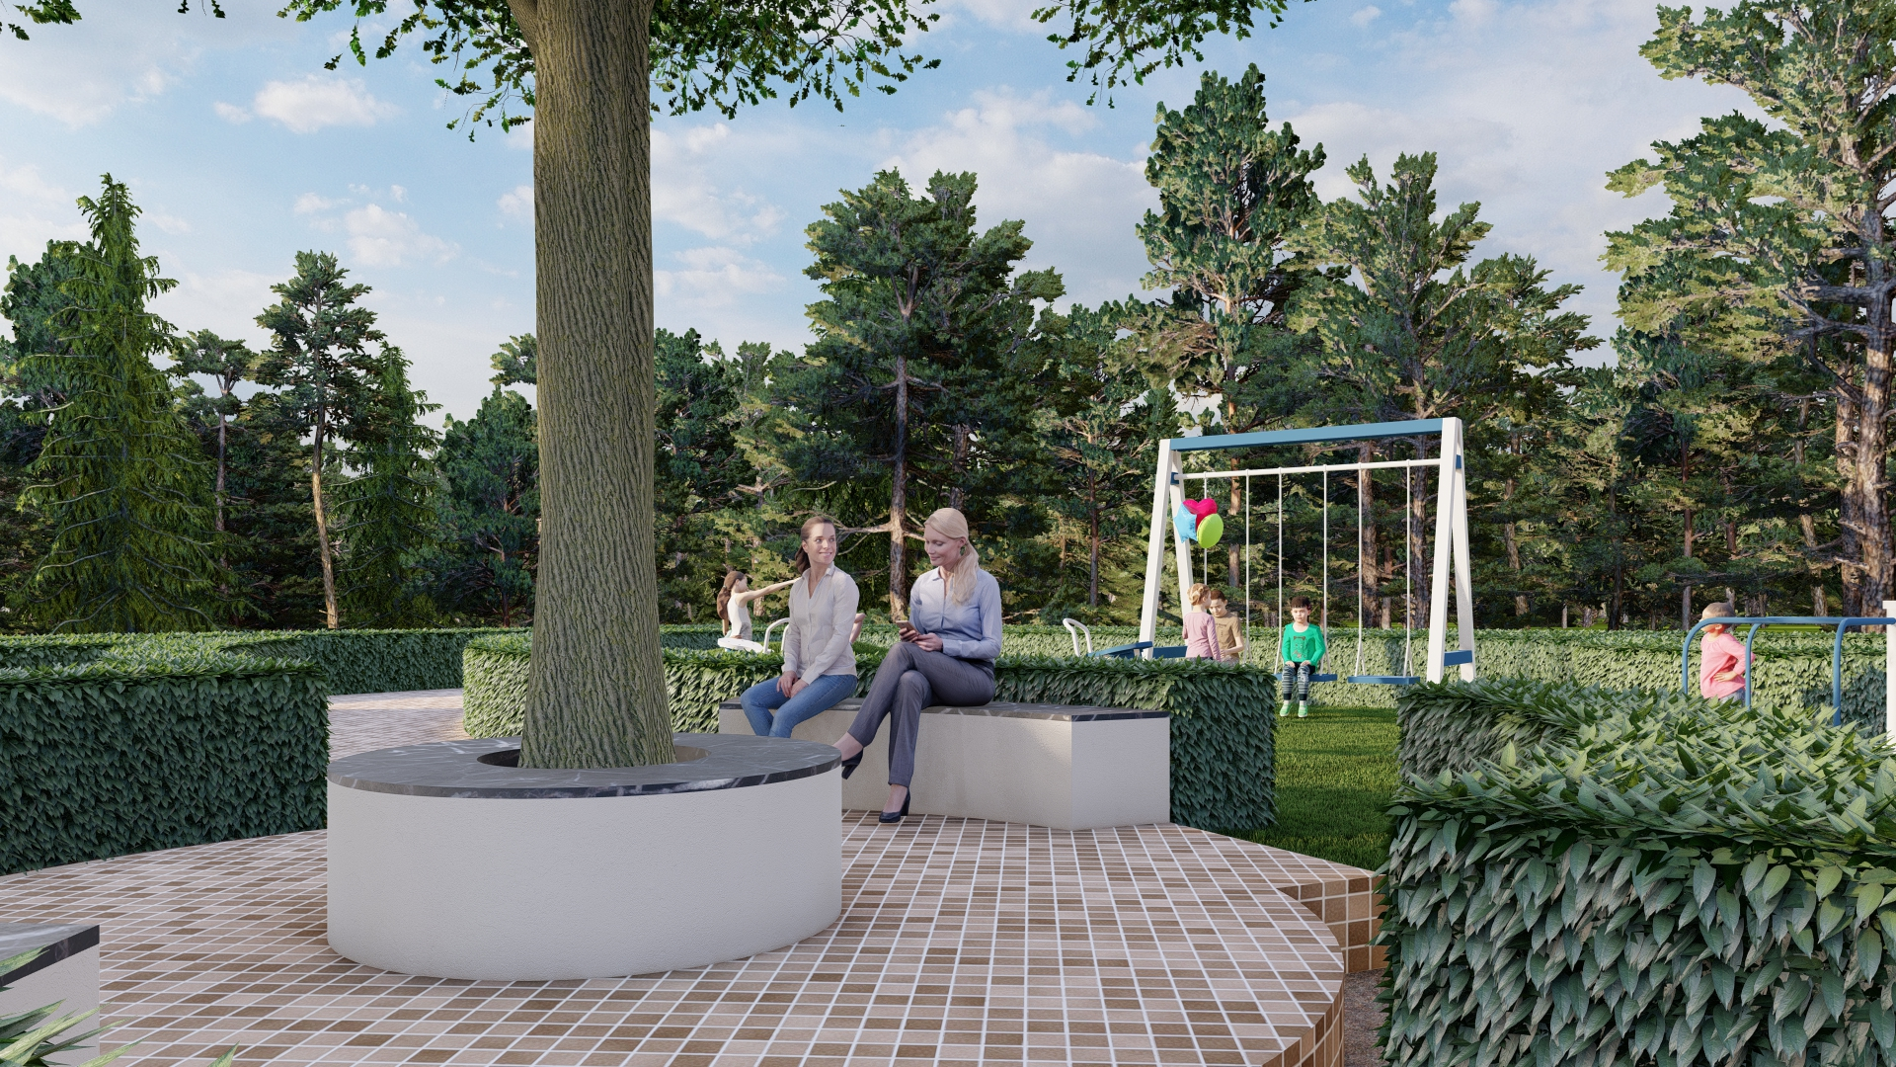
SEATING POINT

Slide 10
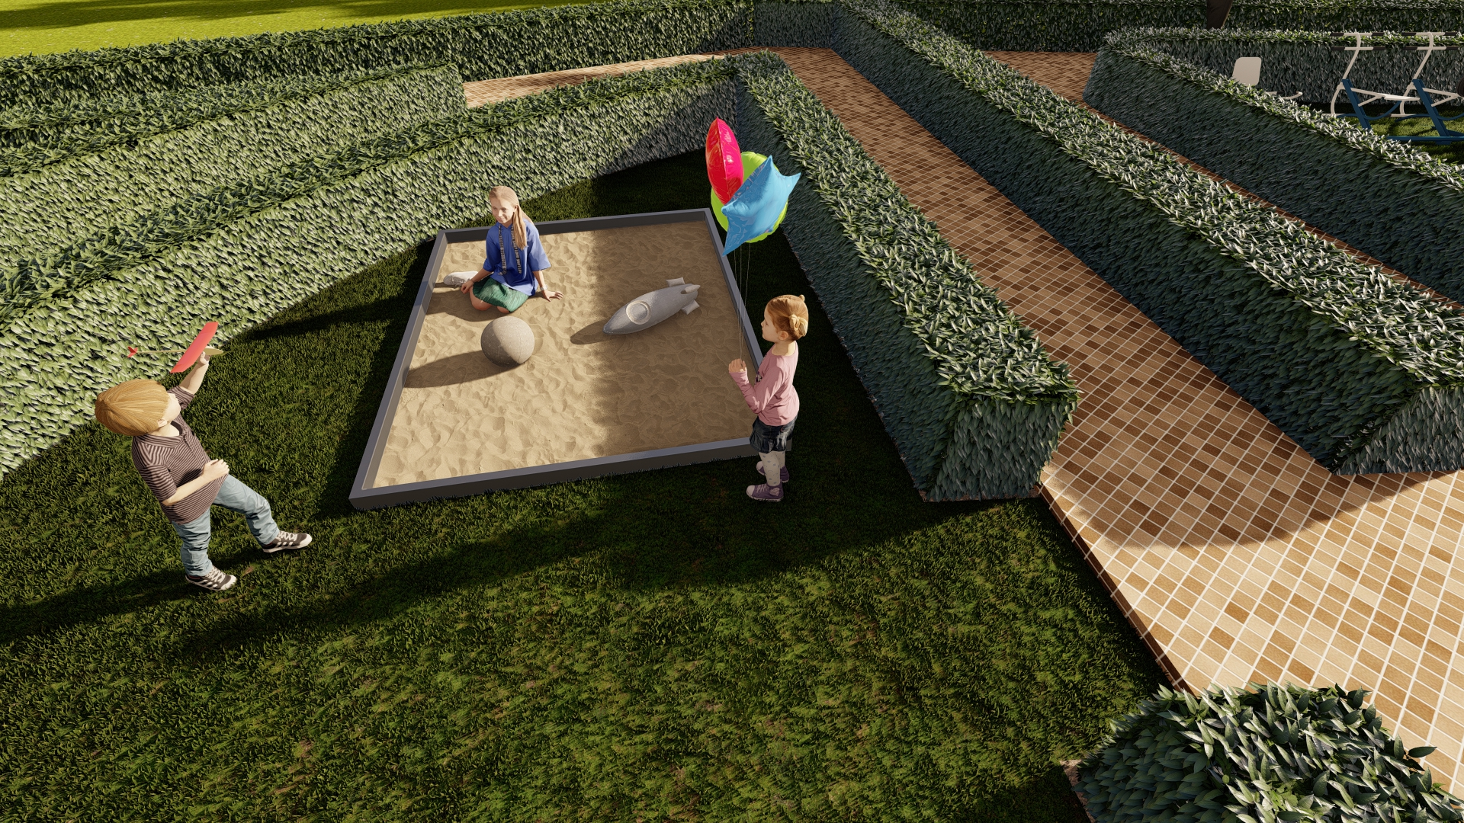
SAND PIT

Slide 11
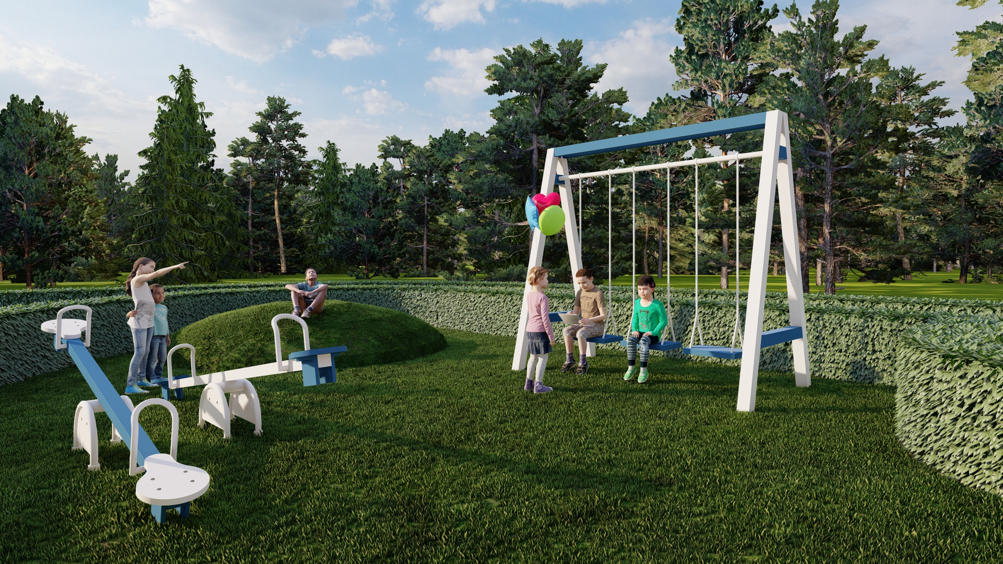
SWING PARK

Slide 12
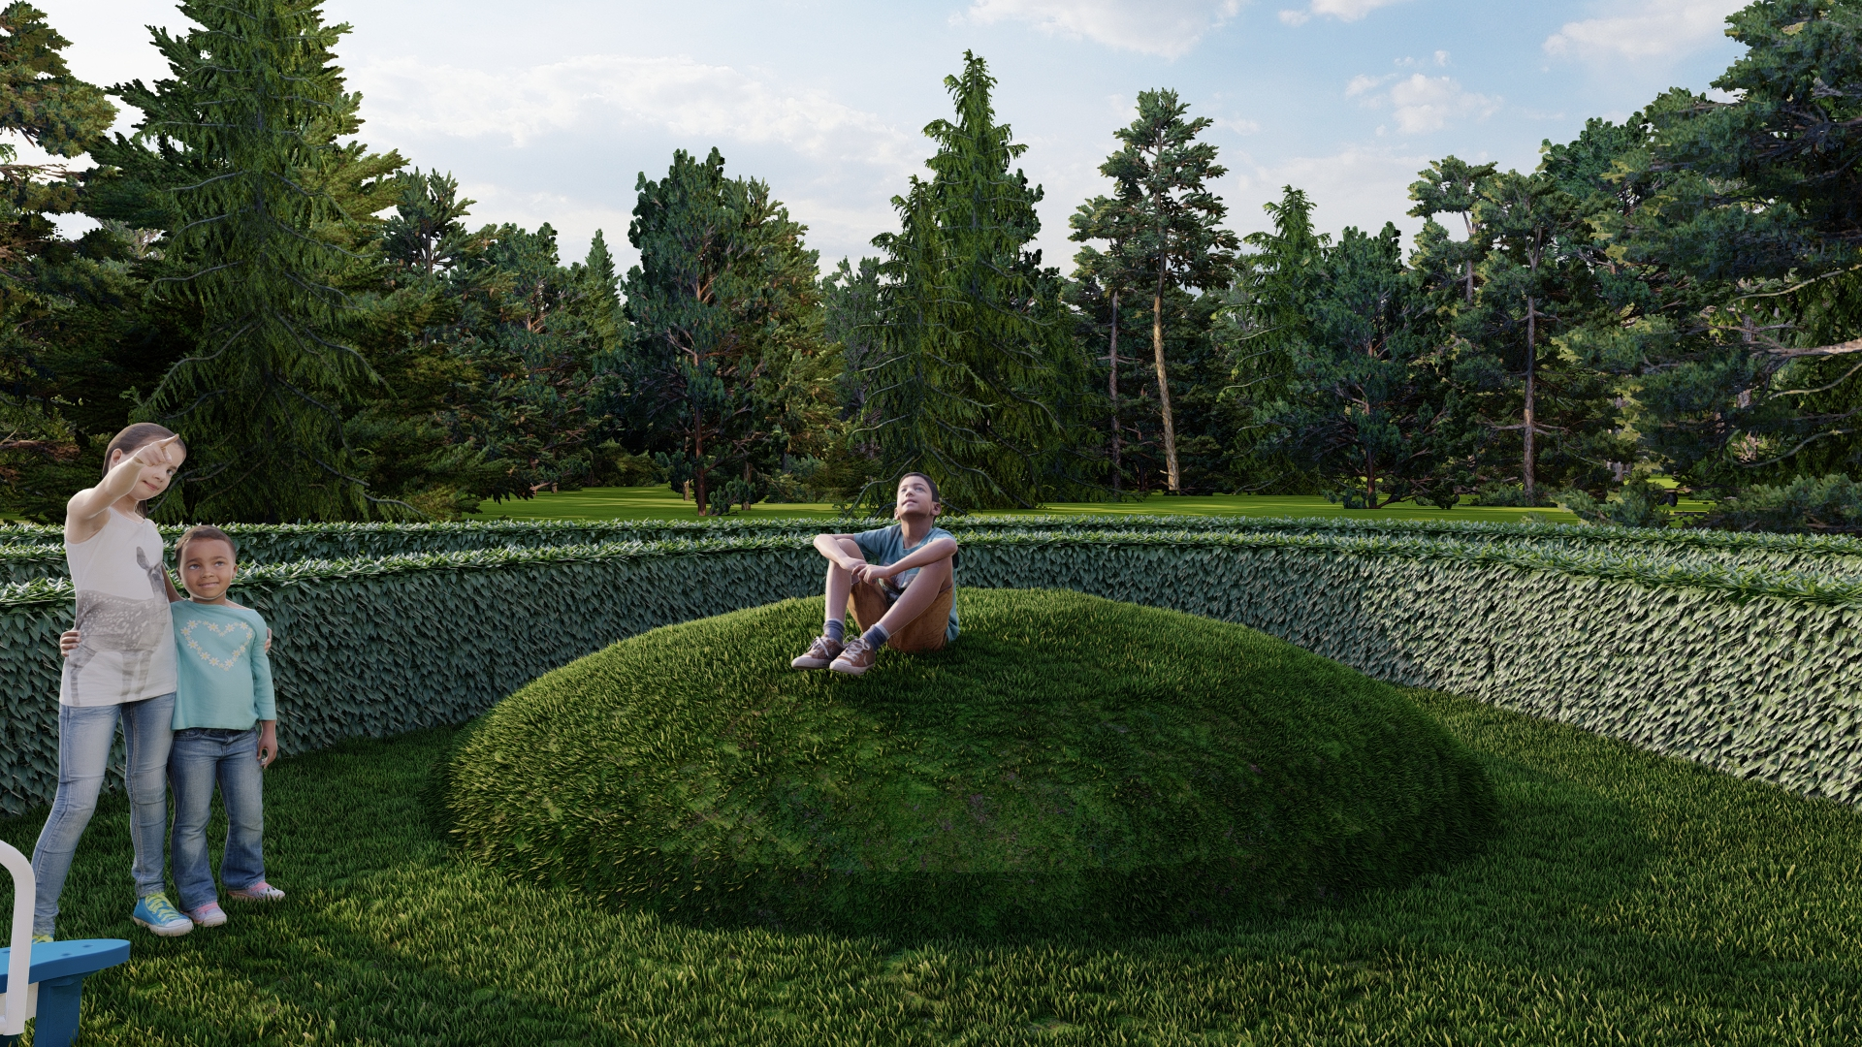
PALYING MOUNDS

Slide 13
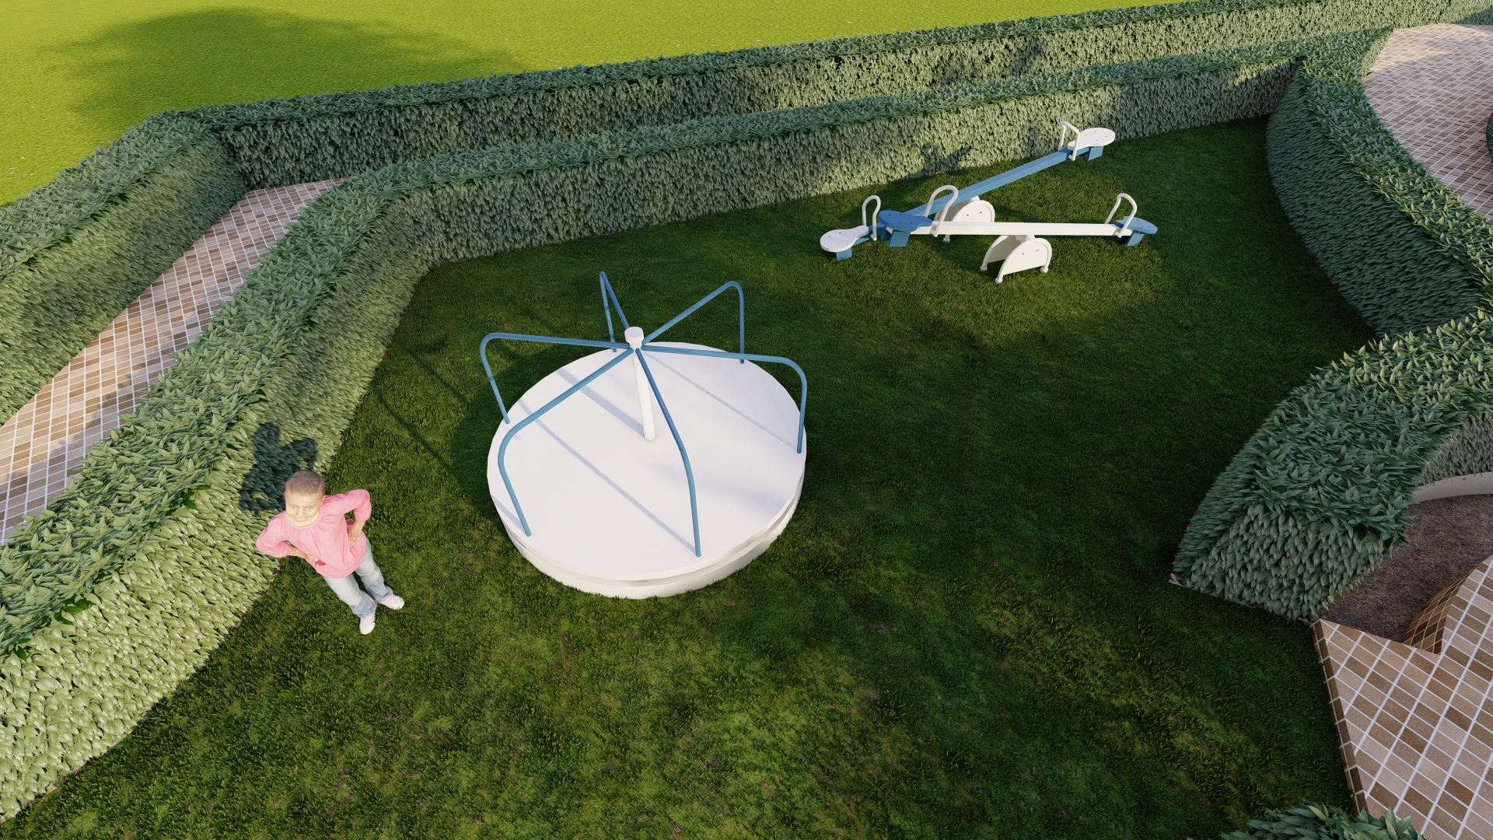
KIDS PLAY

Slide 14
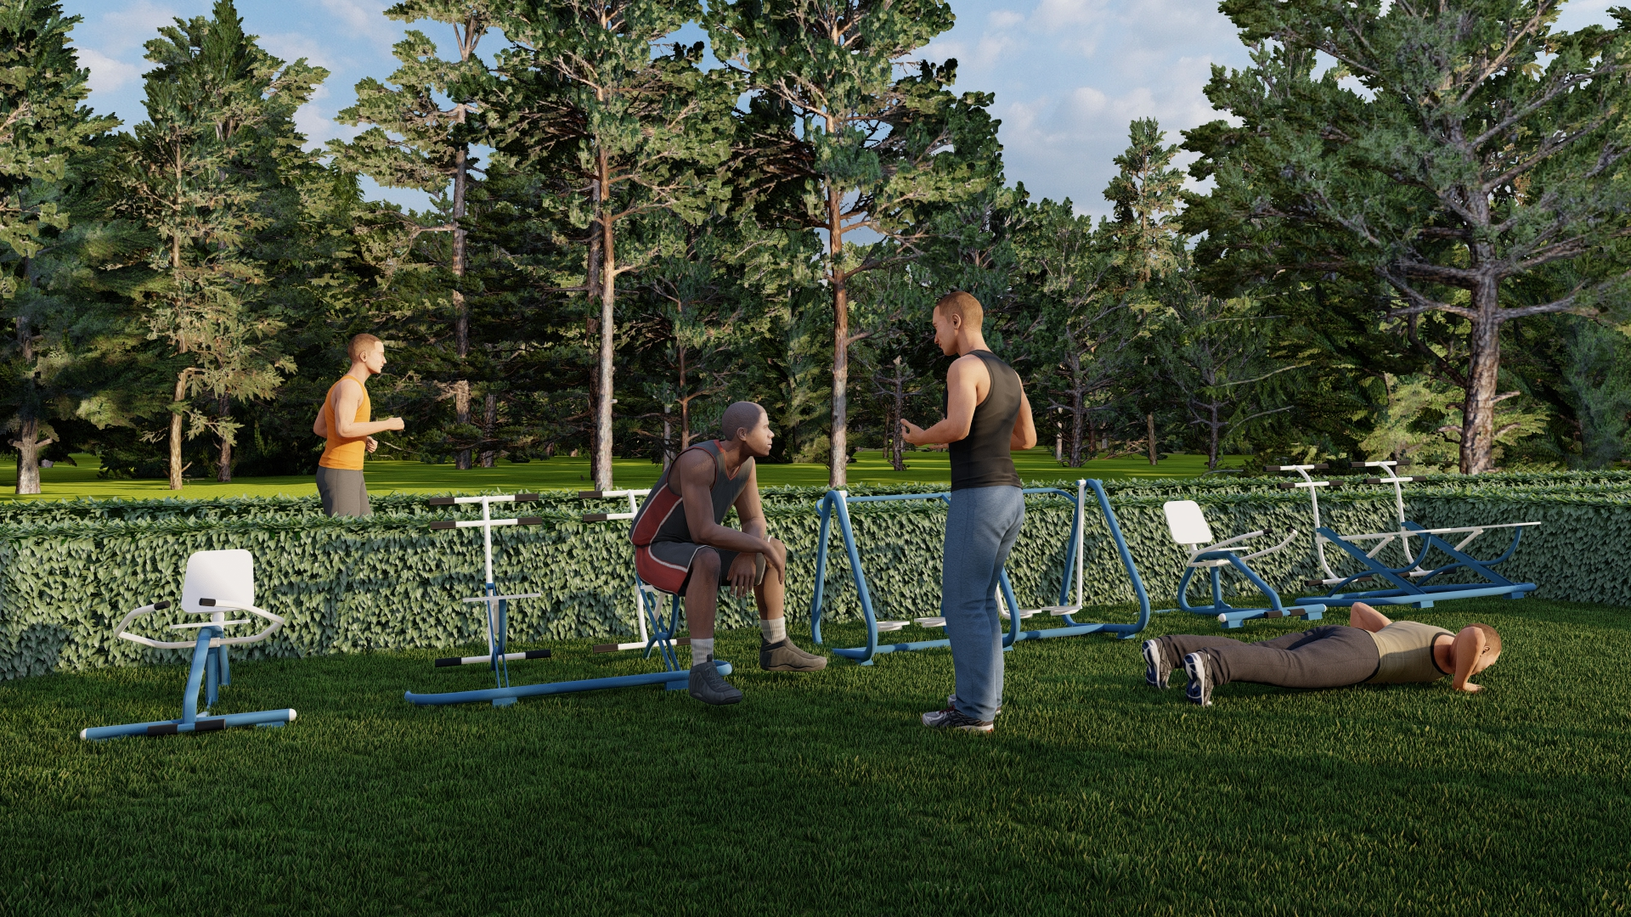
FIT ZONE

Slide 15
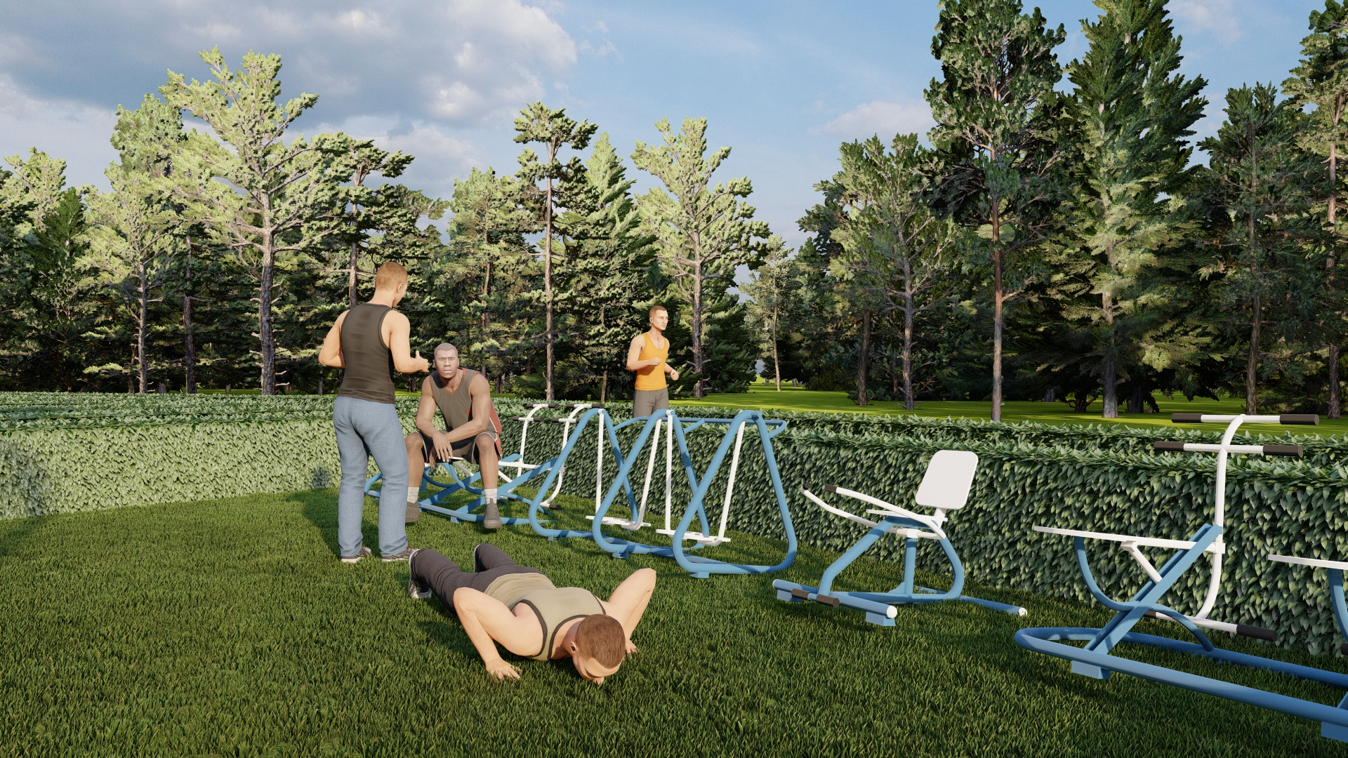
FIT ZONE

Slide 16
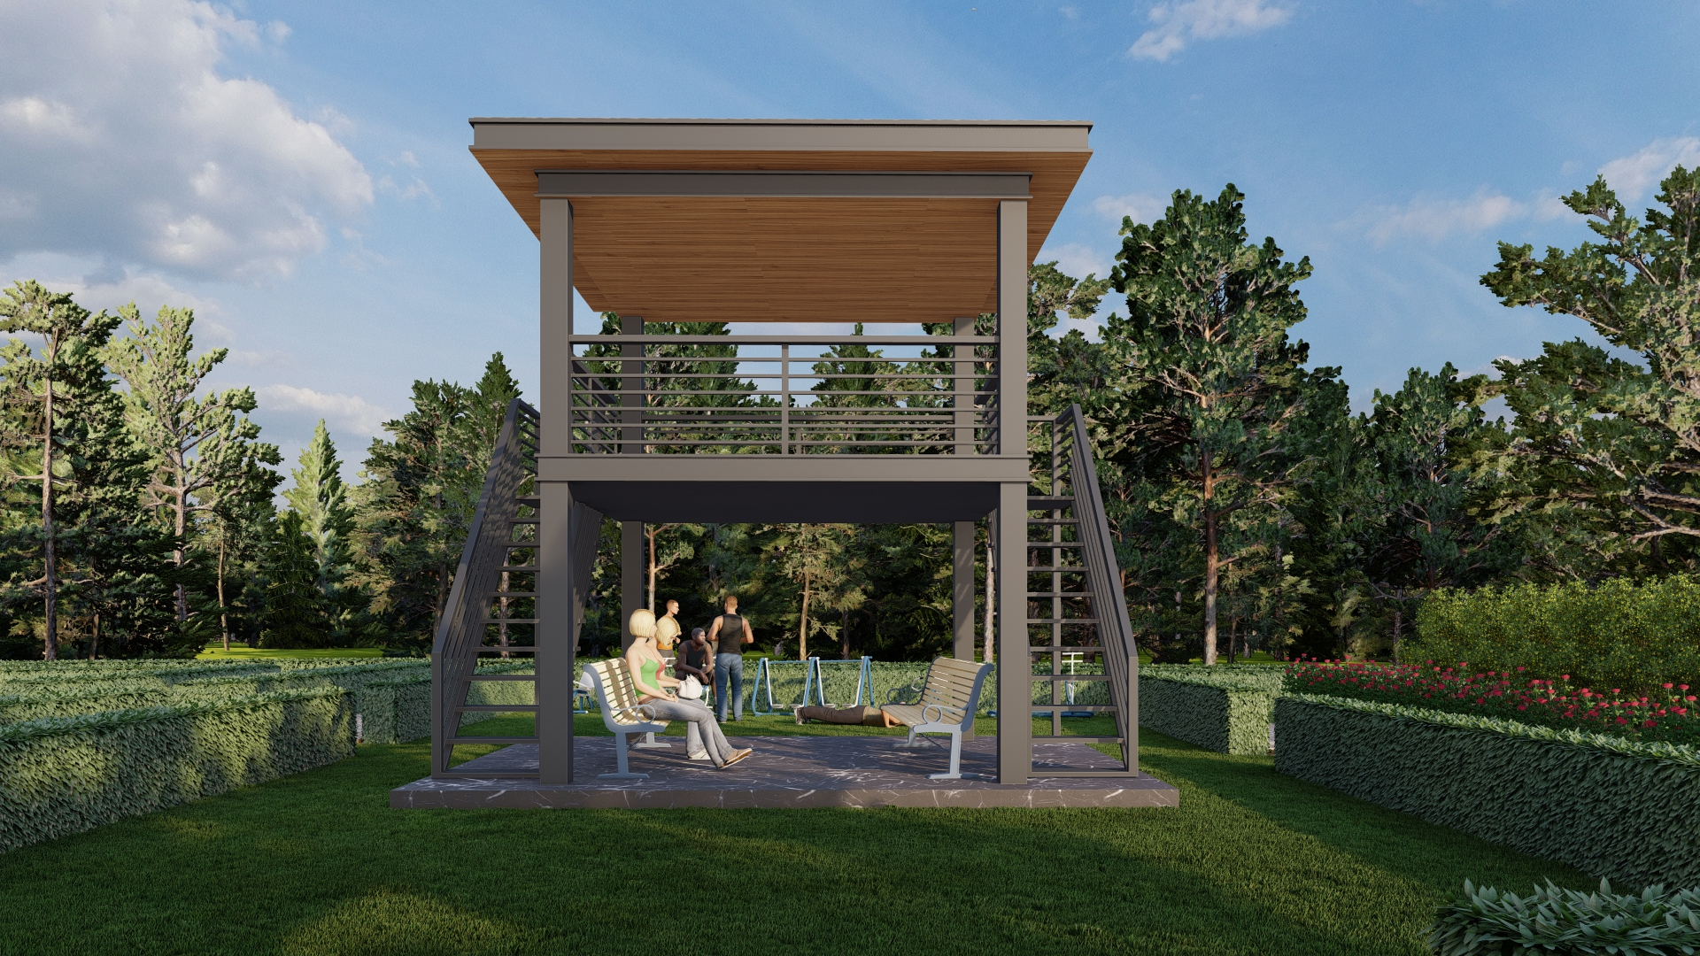
THE SOCIAL COURTYARD

Slide 17
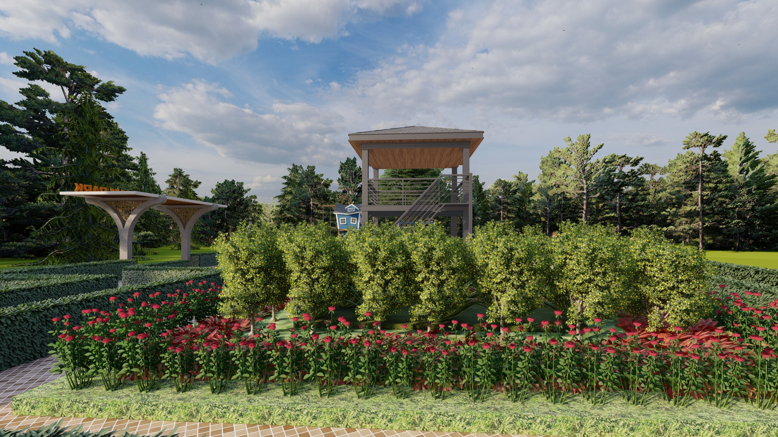
HEALING GARDEN

Slide 18
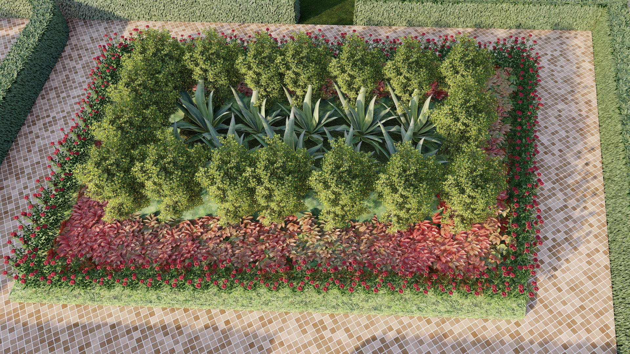
HEALING GARDEN

Slide 19
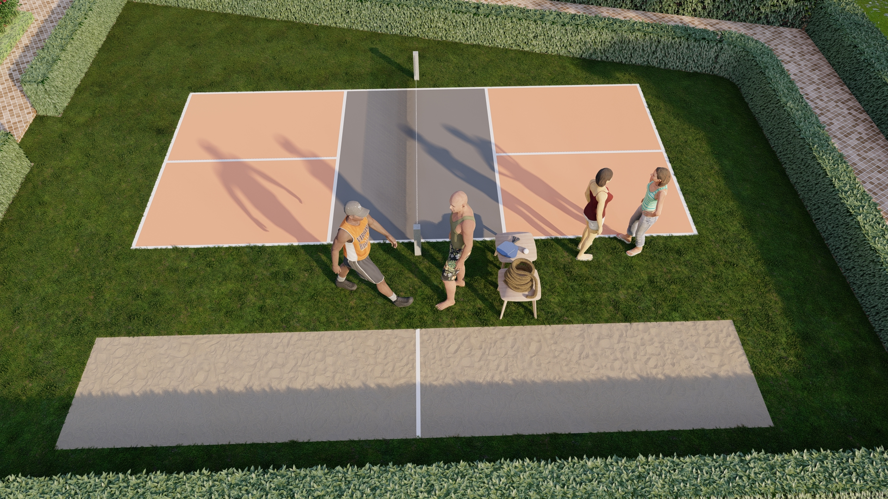
PICKLE BALL & TUG OF WAR

Slide 20
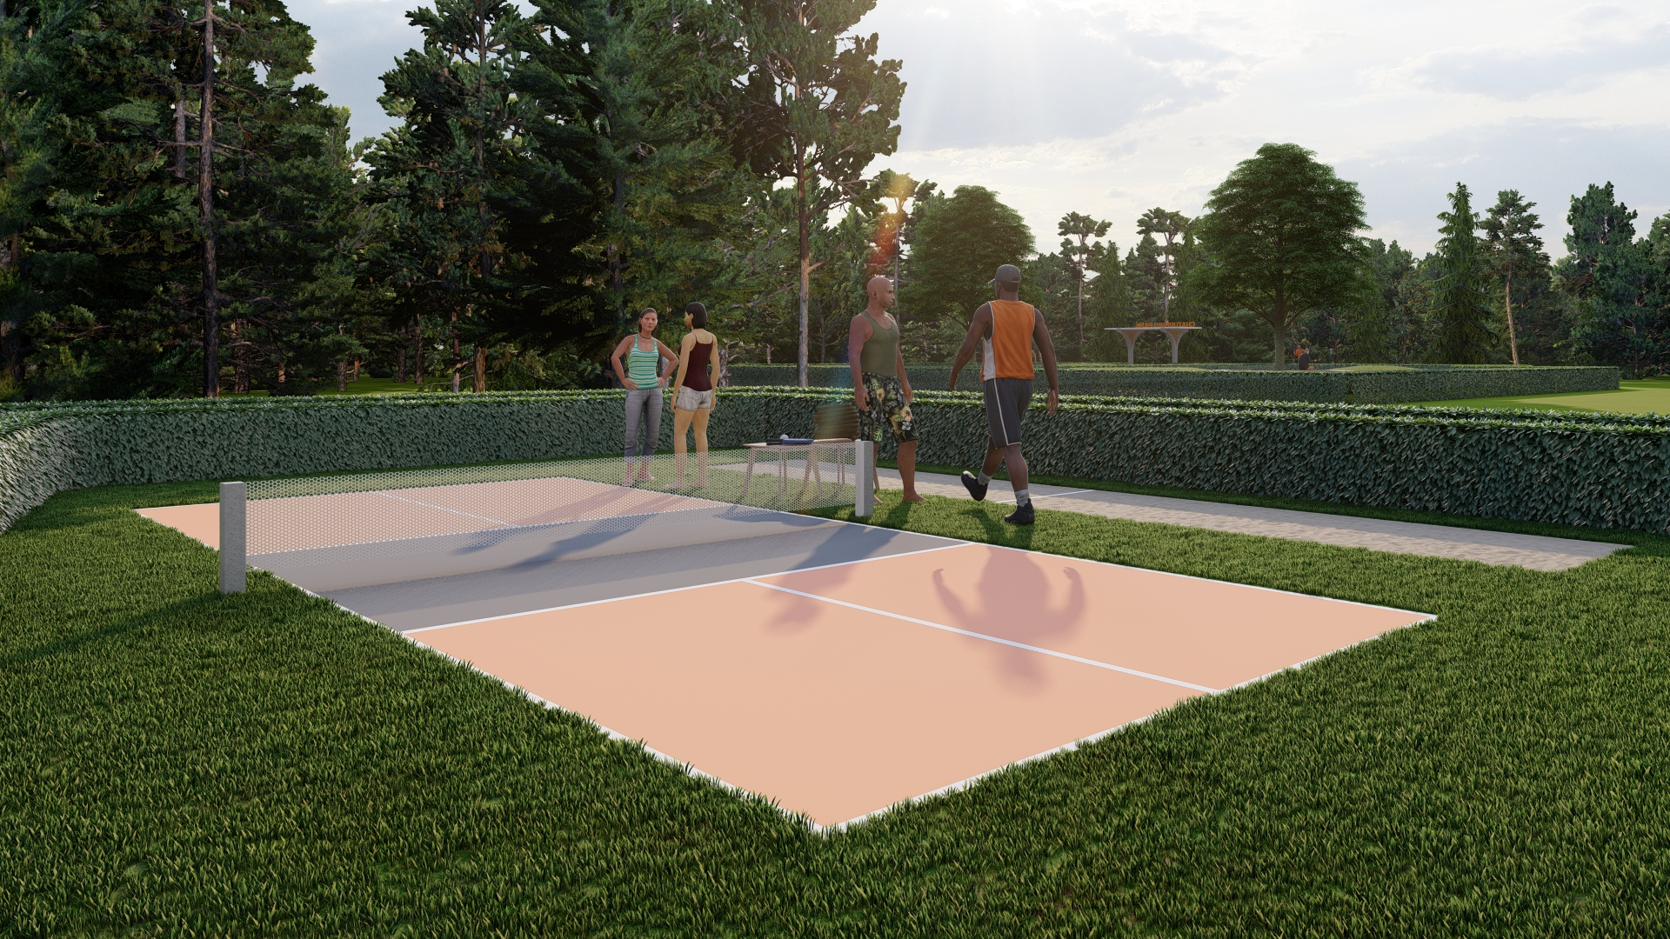
PICKLE BALL

Slide 21
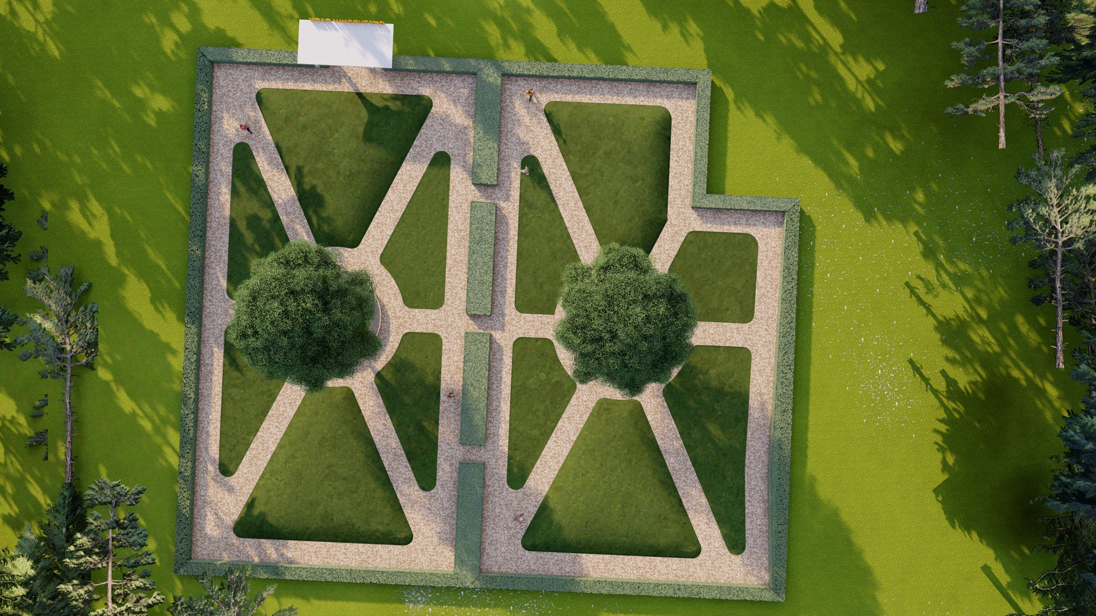
CHATURBHUJ PARK

Slide 22
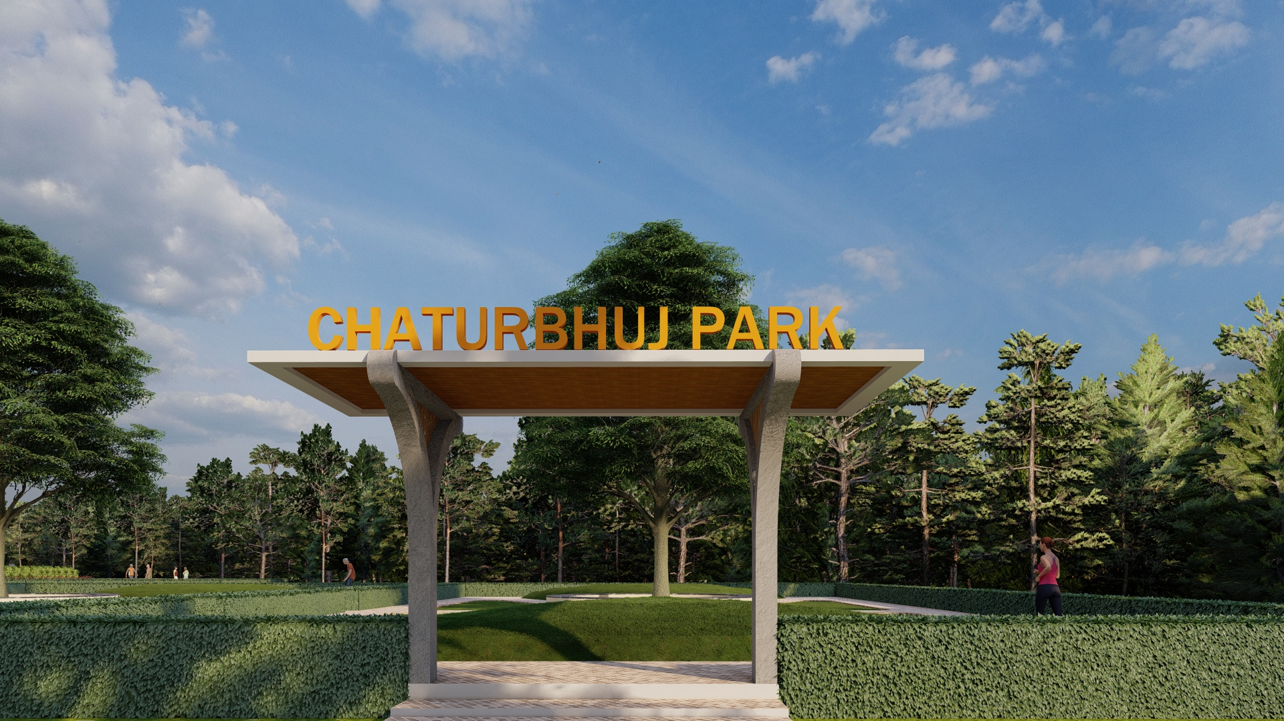
CHATURBHUJ PARK

Slide 23
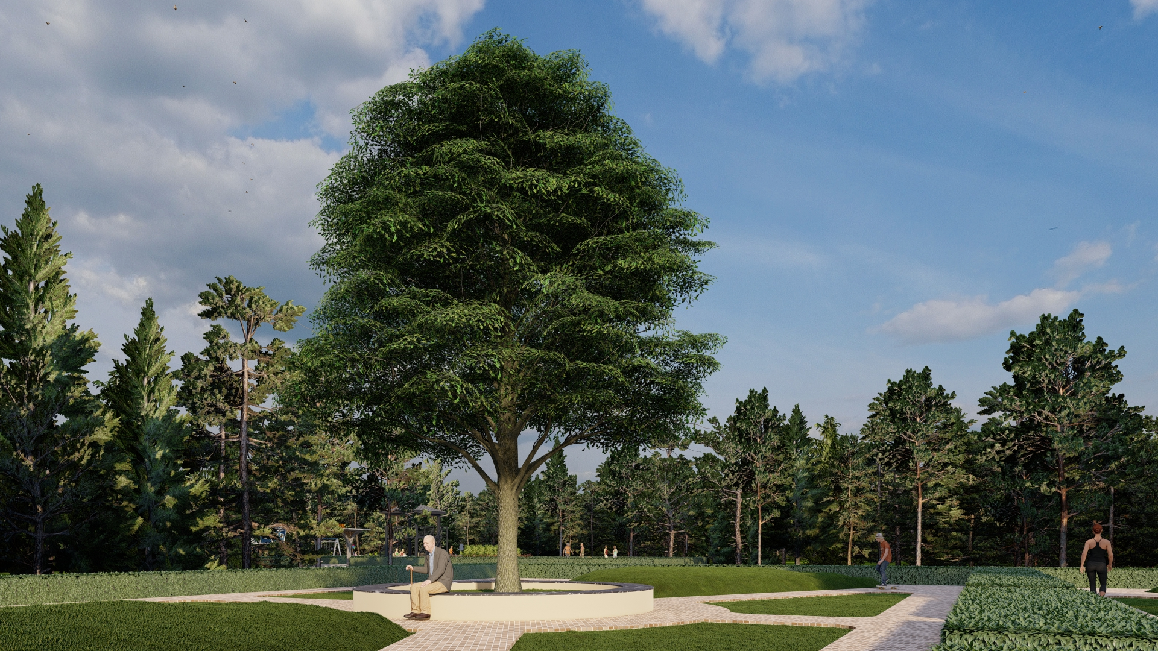
SEATING POINT

Slide 24


